Slide 1
ATAC-Seq overview
Feargal J Ryan
18 – 09 - 2024

Slide 2
ATAC-Seq overview
Accessible chromatin regions are often sites of active promoters, enhancers, and other regulatory elements, which facilitate the binding of transcription factors and the transcriptional machinery

Slide 3
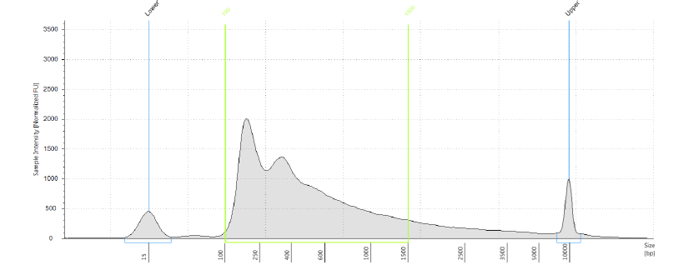
Library QC – Fragment size
Nucleosome-free region
mono-, di- and tri- nucleosome fragments
Vd2 T cell libraries

Slide 4
Library QC – Accessibility enrichment
COVIRS Data
qPCR for known ‘accessible’ and ‘inaccessible’ regions
Accessible: ACTB, VCP
Inaccessible: REEP5, VSP29

Slide 5
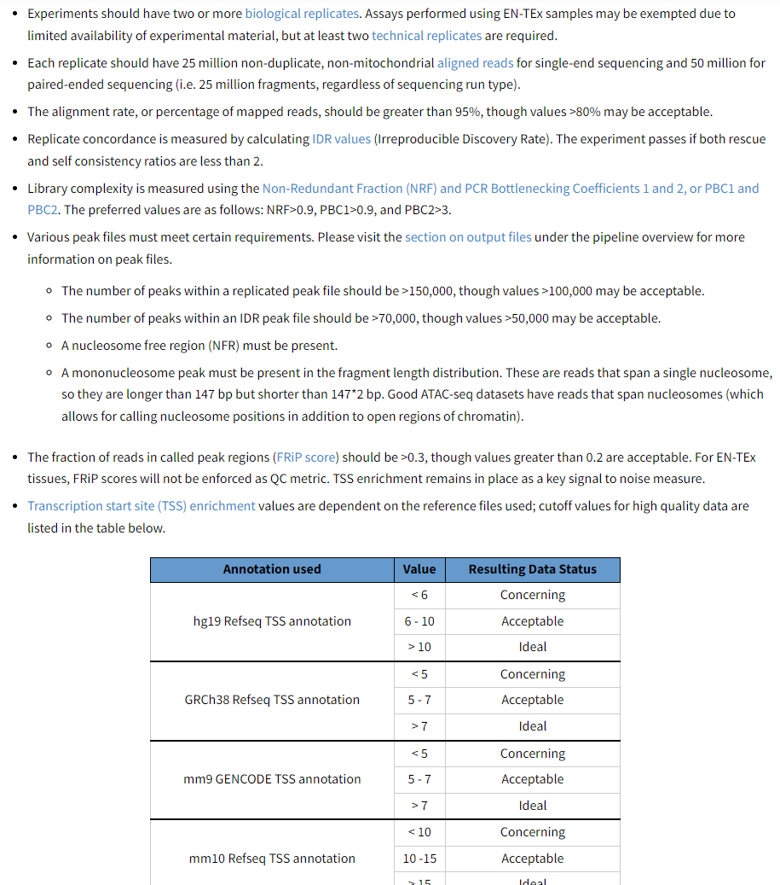
ENCODE ATAC-Seq standards.
The Encyclopedia of DNA Elements (ENCODE) is a public research project which aims "to build a comprehensive parts list of functional elements in the human genome.
https://www.encodeproject.org/atac-seq/
In addition to ENCODE we also implement some of our own sanity checks for validation.

Slide 6
A basic overview of the pipeline
Sequence quality control
Check reads per sample, error profiles, adapter contamination etc.)
Alignment to the reference genome
Manual investigation of alignments through IGV or similar.
ATACSeqQC R package to calculate the transcription start site enrichment, non-redundant fraction and PCR bottleneck coefficients.
Bowtie2 is used for alignment
Estimate mitochondrial reads etc.
Peak calling
Through Genrich on ATAC mode https://github.com/jsh58/Genrich
Counting
Data is converted to SAF format and FeatureCounts is used for counting reads aligned to peaks
Calculate fraction of reads in peaks (FRiP)
Peak annotation
That is annotating where peaks fall. This is done using the ChIPseeker R package. Depending on your hypothesis you want to focus in on certain things (e.g. only
Downstream analysis
At this stage we’ll likely manually investigate some known open/closed peaks to sanity check our data. Then the additional analysis depends a bit on the study design.

Slide 7
Manual investigation of alignments
Genomic DNA wouldn’t be “peaky” it would be equal across mostly.

Slide 8
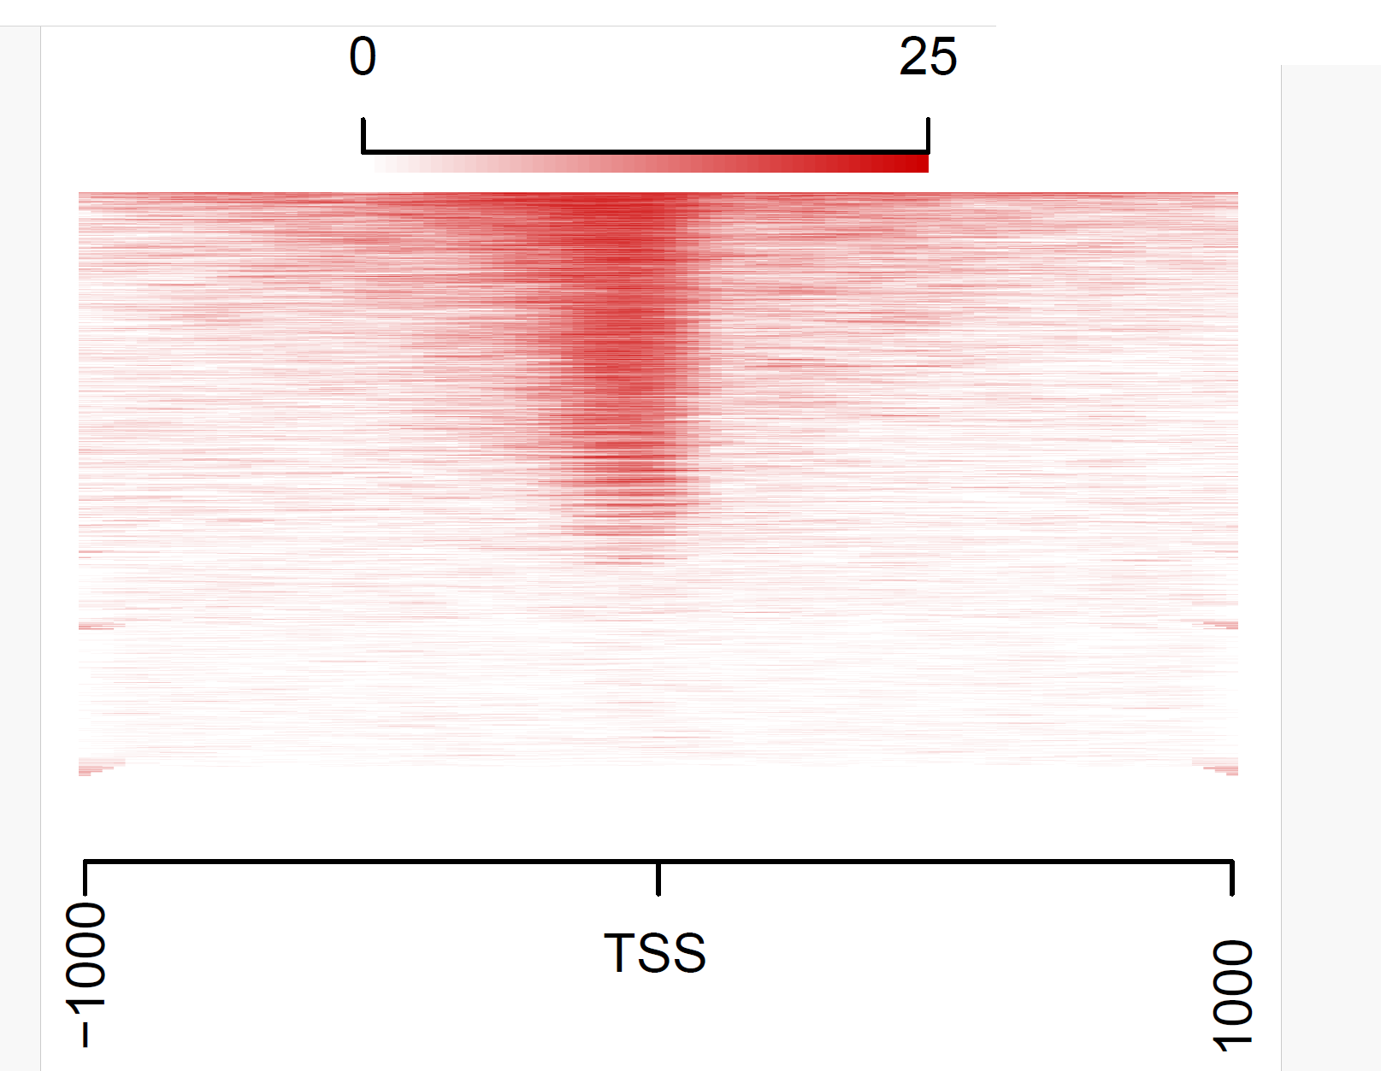
Transcription start side enrichment

Slide 9
Example peak annotation
Peak annotation with this type of data is somewhat limited. DNA can be arranged differently in 3D space, so certain areas could be close together but far apart in 2D sequence. This can be investigated with Hi-C sequencing which is a different approach.
Basically take the peak annotation with these sorts of data with a pinch of salt.

Slide 10
Additional sanity checks
Samples from the same person largely cluster together

Slide 11
Example accessibility ratio at control open/closed peaks

Slide 12
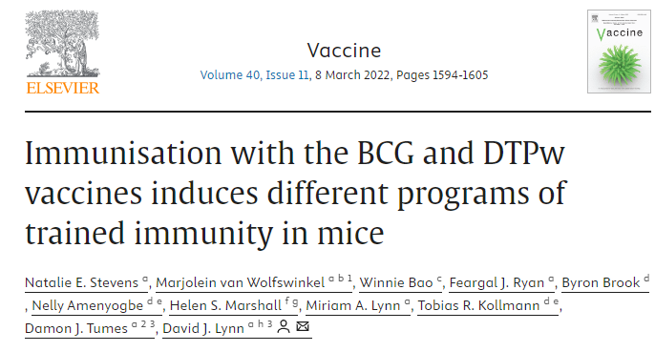
If you want to know more dig into the methods of these two papers
Notes:
And so after my PhD I moved intot he virus space for a couple of years. Colin had just started his lab there. Lorraine draper who is now the lab manager there had just wrapped her PhD, Andrey had just joined the team etc and what they were keen to do was build up their bioinformatics capacity. So that’s where I came in to run their bioinformatics for the whole lab. When I joined that lab in 2016 they had generated a lot of metagenomic data and to analyse this was aligning their reads to RefSeq virus genomes and a bit perplexed about why so few reads were aligning. So I said ok lets throw that out and start from scratch, which is where I helped them develop an assembly based protocol which basically served as the basis for all of their work for years and I think still does. Through this I developed an approach for taxonomic classification too (Which I think now is painfully outdated) as well as a way for tracking bacteriophages engraftment post FMT. Turned out to be most productive period of my career, I worked there for less then 2 years and co-authored something like 12 papers. I also absolutely loved working there. Colin and I would have regular chats in the elevator about how to tackle the problem of ”dark matter” in the microbiome.

